Slide 1
Crestron XiO Cloud®
Technology Operations Management
Details

Slide 2
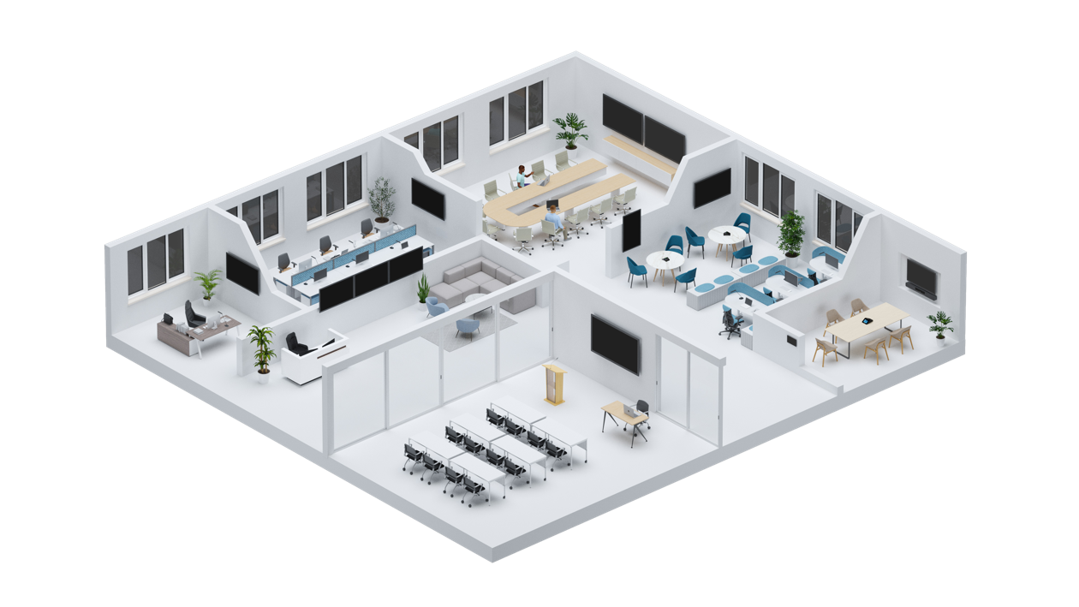
The AV/IT Challenge
Overburdened AV/IT teams lack the resources to support and the insights to optimize room technology at scale
You may have thousands of these rooms distributed globally, which makes support nearly impossible
You often don’t have visibility or control of all the devices in all the rooms

Slide 3
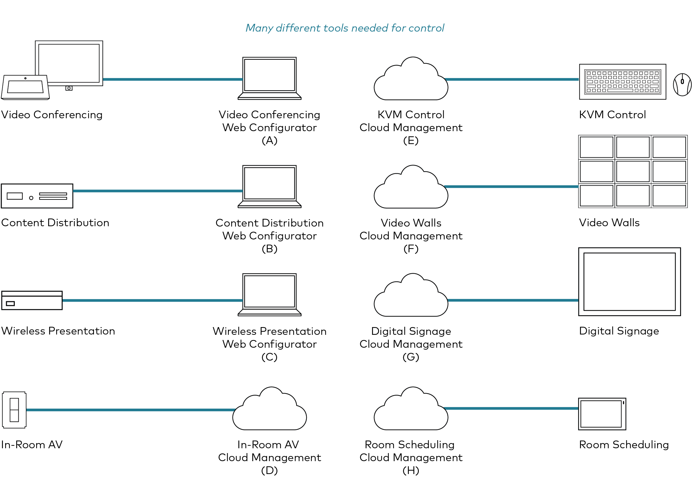
AV/IT Challenge
Room systems are difficult to manage and support because:
Not all devices are on the network;
Those that are offer varying levels of functionality, and;
All require different web or cloud-based tools
Room systems are not always stable or reliable due to changing APIs and device firmware updates
High cost of ownership due to additional hardware, software, cabling, programming, and labor requirements

Slide 4
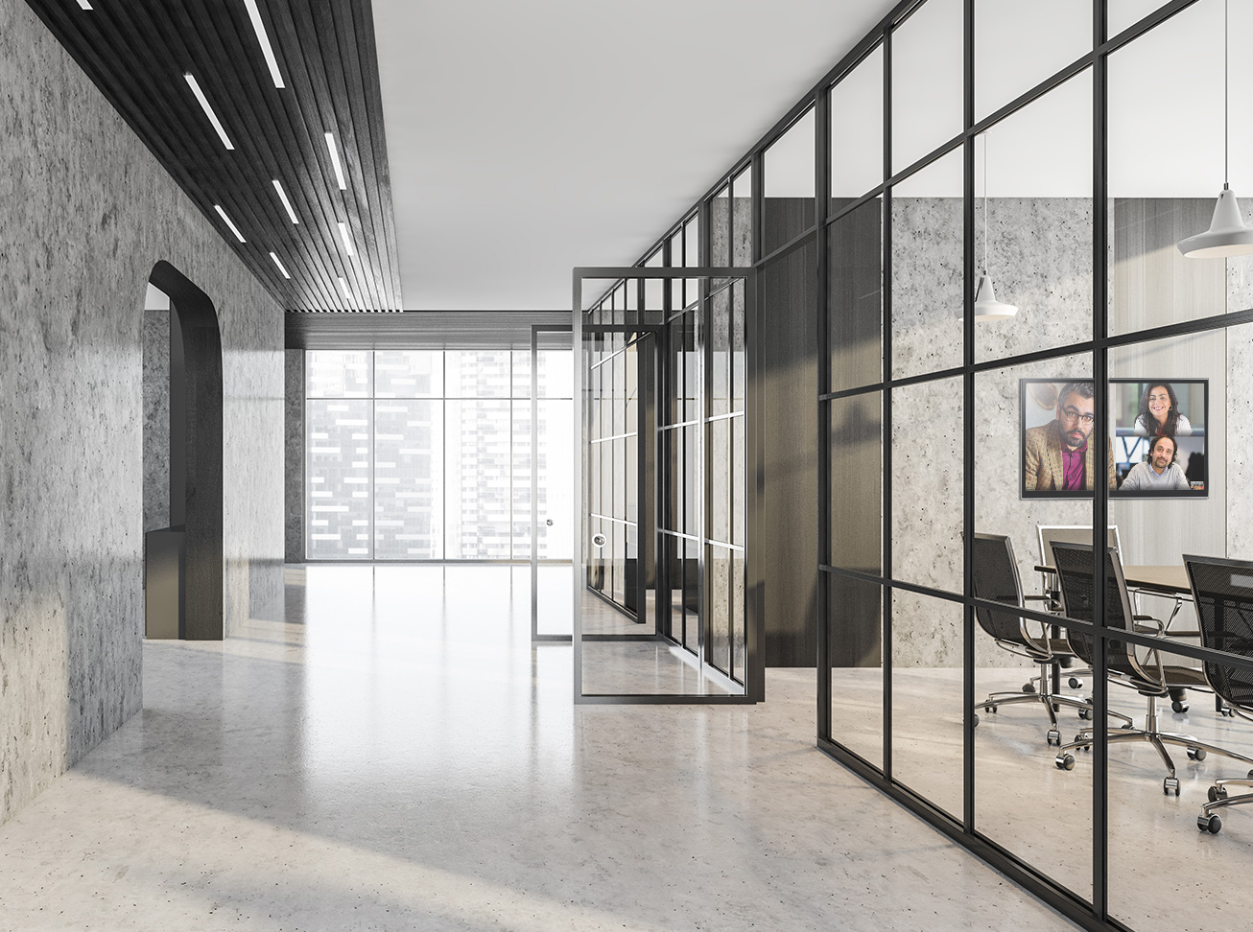
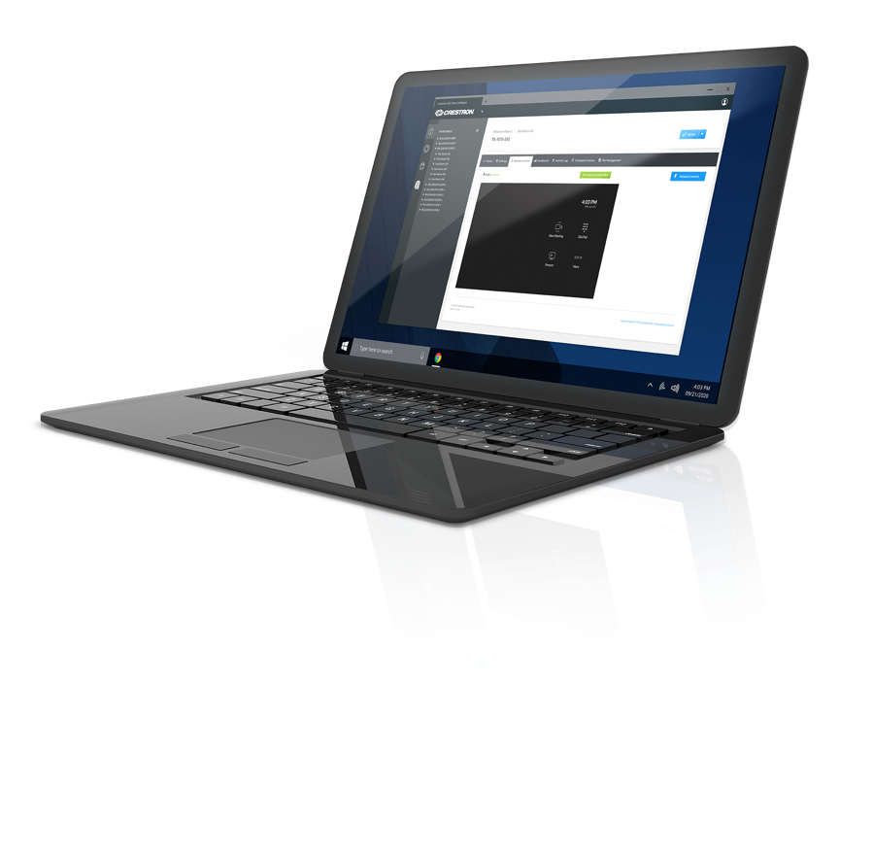
Crestron XiO Cloud
Technology Operations Management
Optimize workplace technology operations and maximize room uptime efficiently at scale

Slide 5
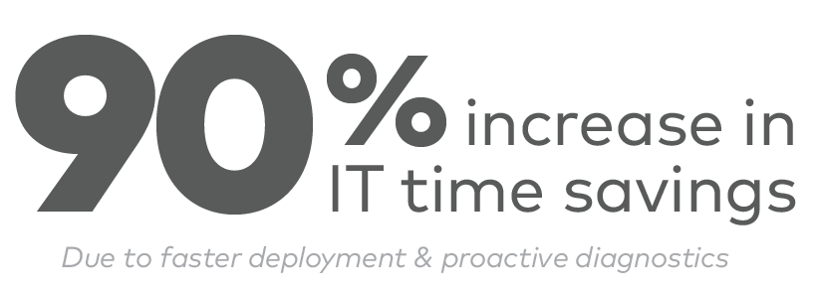
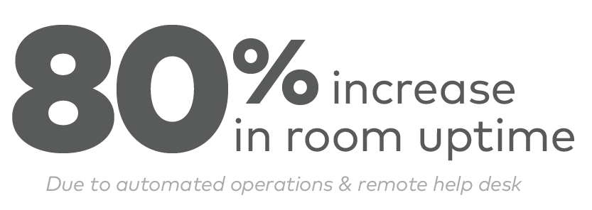
At a Glance
Accelerated Support Services | Increased User Satisfaction | Automated Technology Operations
Automated alerts for all rooms | Rooms always work | Remote device configuration and deployment for all devices
Remote troubleshooting of all devices | Consistent user experience | Real-time device and room health monitoring
Remote control of all rooms | Rapid support response | Remote support for all devices and rooms
Single view of entire connected system |  | Update Management and Data & Analytics
^{*Data based on Internal Survey}

Slide 6
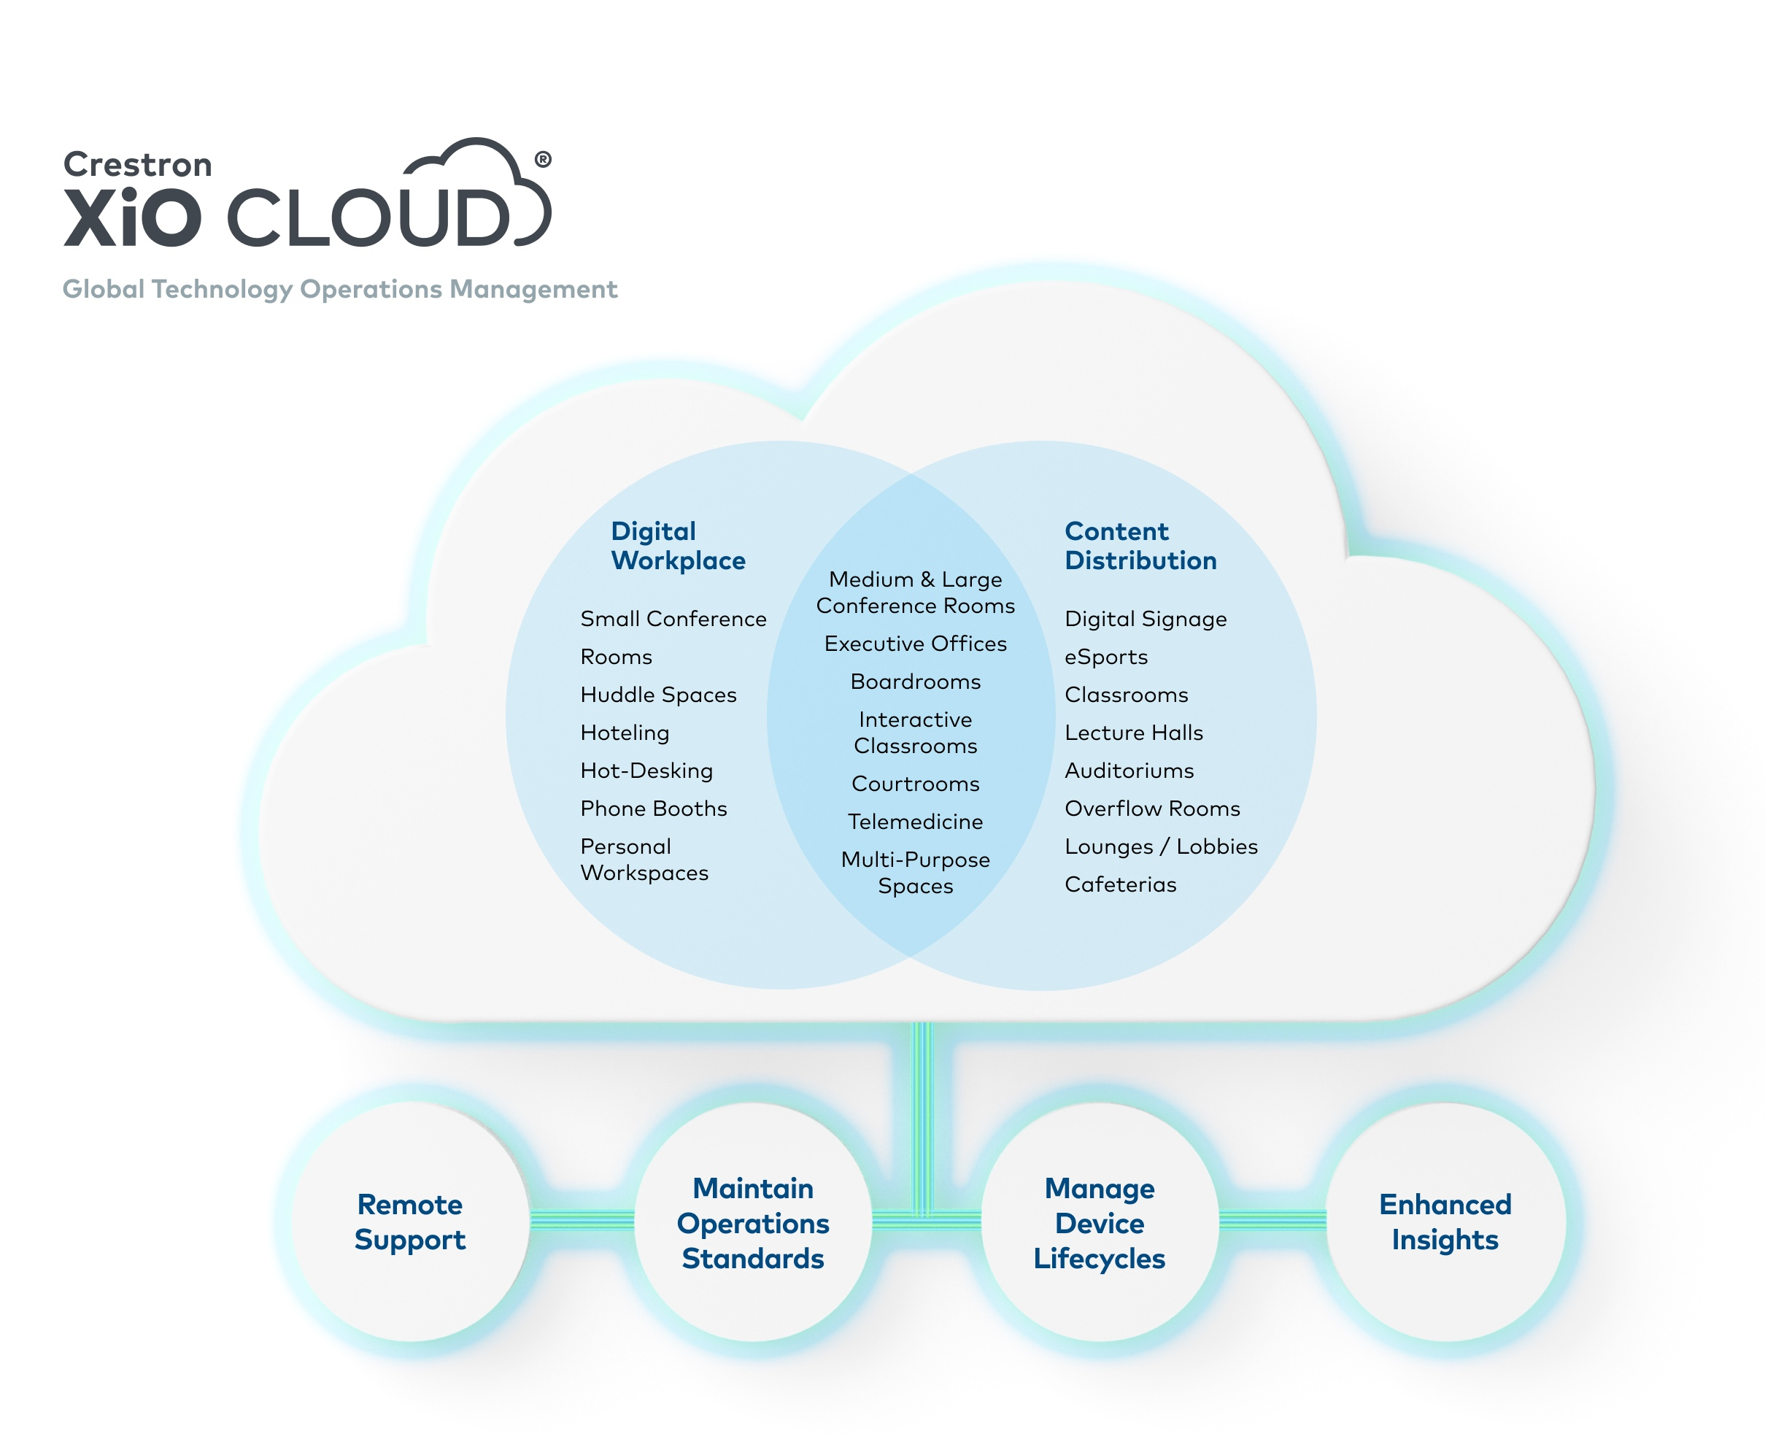

Slide 7
Remote Support
One Solution: XiO Cloud
Get automated, event-based alerts so you can resolve issues before anyone even knows there was a problem so meeting are not delayed or disrupted
Take control of devices remotely to troubleshoot and resolve technical issues faster and increase room uptime which results in increased productivity and worker satisfaction
Integrate support workflows, such as ServiceNow into Crestron XiO Cloud for greater efficiency

Slide 8
Maintain Operation Standards
One Solution: XiO Cloud
XiO Cloud provides a single dashboard for visibility to device licenses and firmware/software versioning
Simple, comprehensive visibility to device lifecycles enables you to more efficiently schedule updates, prepare budgets, and anticipate needs

Slide 9
Manage Device Lifecycles
One Solution: XiO Cloud
Establish standard room configurations and deploy remotely to individual or groups of rooms at the same time which saves time, increases room uptime, and mitigates risks
Firmware and software updates may be pushed remotely to individual, group, or all devices at the same time which saves time, increases room uptime, and mitigates risk
Establish event schedules for turning devices on and off

Slide 10
Enhanced Insights
One Solution: XiO Cloud
Automatically collect room and device usage data and generate reports for enhanced insights to drive better planning and budgeting
Gain detailed understanding about what technology is used down to individual button presses; how it is used including connectivity methods, and frequency of use

Slide 11
Technology Operations Management
Scale and support all your rooms and devices with ease
Task | Old Way | Now with Crestron XiO Cloud | Benefits
Configure & Deploy | Each device manually and individually | Store device configurations in advance and push to individual groups, or all rooms at the same time | Save time. Increase room uptime. Reduce risk.
Support | Wait for support call and then physically send technician to the site | Get automated alerts and troubleshoot remotely | Issues are resolved faster and without disrupting meetings. Increased room uptime, productivity, and satisfaction
Manage | Rely on multiple manual spreadsheets to track device lifecycles | Single dashboard visibility to device lifecycles | Increased efficiency. Ability to schedule updates, prepare budgets, and anticipate needs
Update | Each device manually and individually | Schedule and push updates remotely to individual, groups, or all devices at the same time | Save time. Increase room uptime. Less risk.
Analytics | Manually generated reports from inferred data points (display is “on”) | Automatically generate reports based on detailed device usage data | Enhanced insights to drive data-driven planning and budgeting

Slide 12
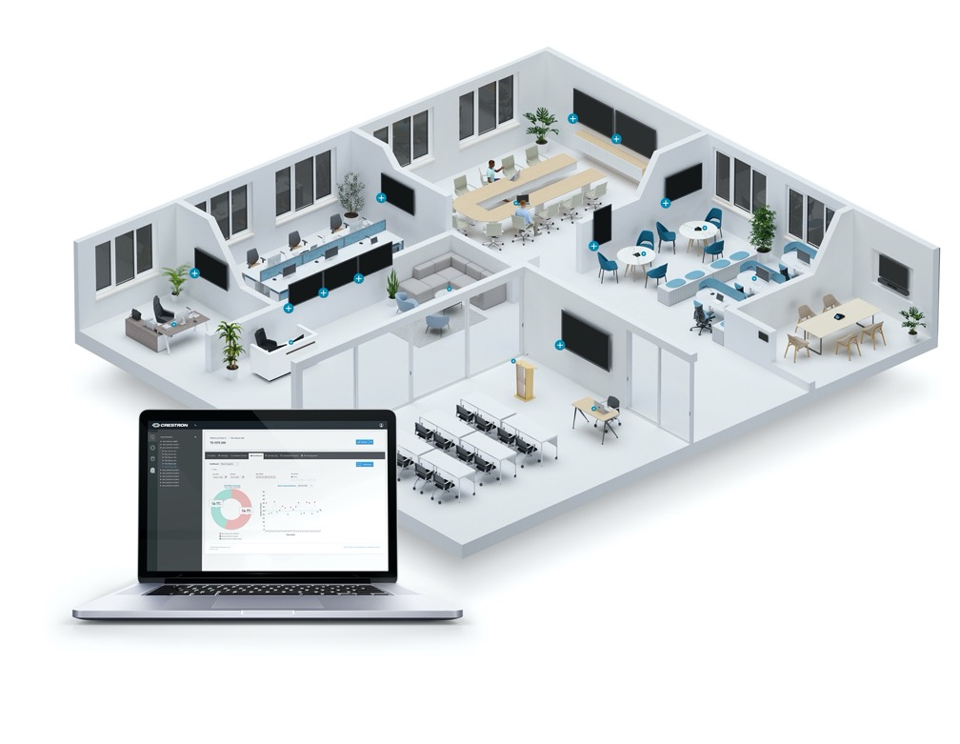
The Crestron Ecosystem
Crestron XiO Cloud is the one unifying operation management platform that is built-in to all Crestron products and many third-party devices
Crestron hardware connects directly to the cloud without any additional hardware or software
Crestron Connected® devices, such as Samsung® displays, also connect directly to the cloud without any additional hardware or software
Other Ethernet-connected devices, web services, and web apps integrate

Slide 13
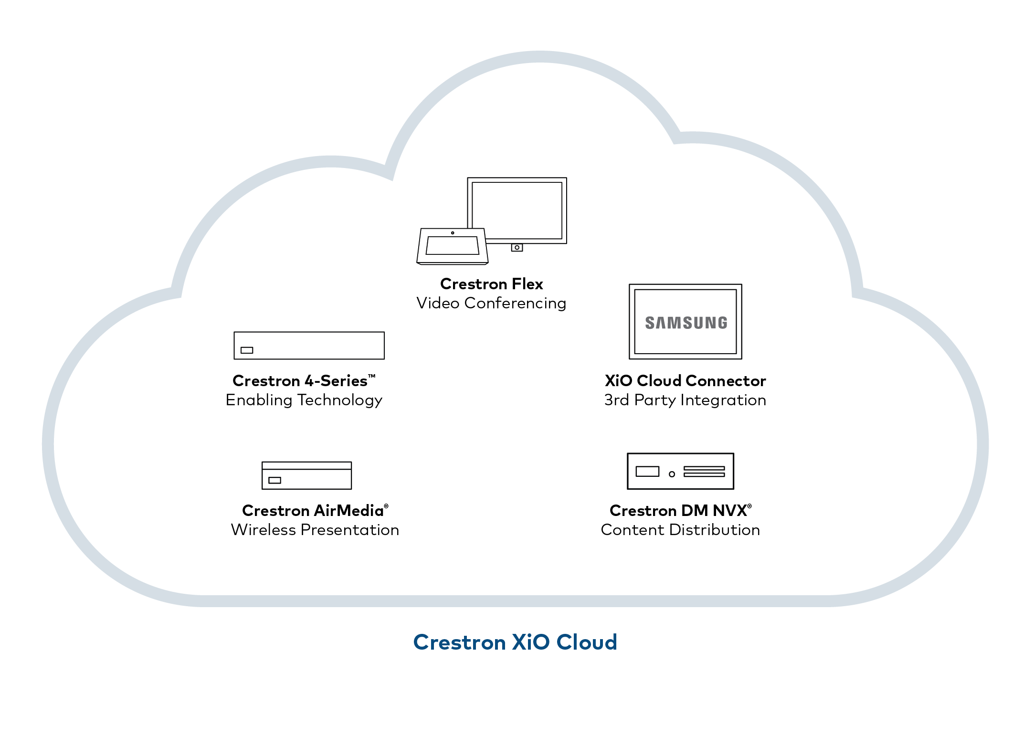
Technology Operations Management
Crestron XiO Cloud platform:
Enables scalability, consistency, reliability, and flexibility to evolve as organizational needs change
Provides a single service to deploy and manage all your rooms globally
Significantly lowers your cost of ownership due to less hardware, software, programming, and labor
Is built into every Crestron product
Many popular third-party devices, and can integrate other Ethernet-connected devices, web services, and web apps

Slide 14
Licensing
Service | Key Feature | Room Price per Month (Advertised Price)
Endpoint Management (Required) | Provision offsite Manage remotely | $3
Support | Support remotely Receive alerts Incident dashboard | $4
Workplace Analytics | Receive actionable usage data | Beta version provided at launch
API Access | Easily integrate with preferred Business Intelligence or Management tools | $1
Total Monthly Cost per Room (if all services selected |  | $8

Slide 15
Learn more
Get Started with Crestron XiO Cloud
For more information, visit crestron.com/xio
Get in touch with a Crestron representative
FPO

Slide 16
Thank you
Learn more at crestron.com/xio

